Slide 1


PIZZA PARTY
SQL PIZZA CRUNCH

Slide 2
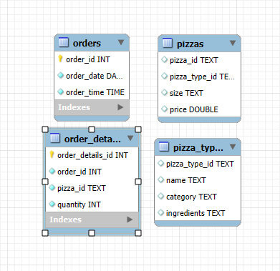
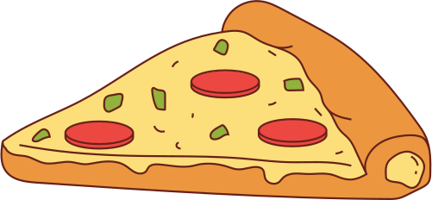
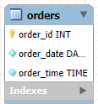
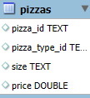
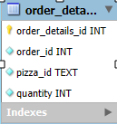
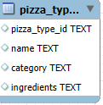
Toppings & Tools:
The SQL Recipe
This pizza is amazing!

Slide 3
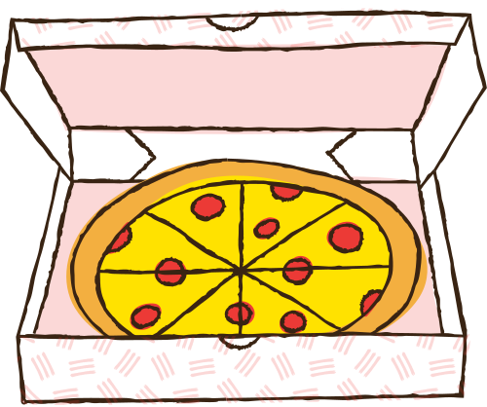
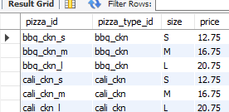
pizzas(table)
Thank you for the pizza.

Slide 4


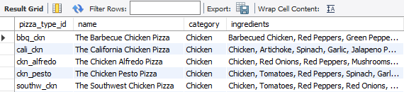
pizza_types(table)
Pizza Palace is where I buy pizza.

Slide 5

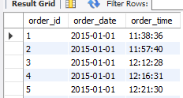
orders(table)
Would you like some pizza?

Slide 6

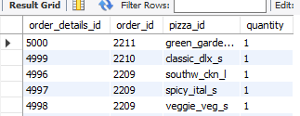
order_details(table)
I need cheese, tomato and olives.

Slide 7
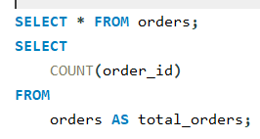


-- Retrieve the total number of orders placed.
"This pizza is mine," said Dad.

Slide 8
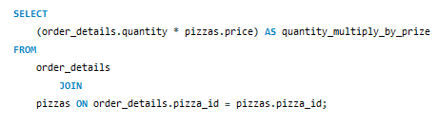
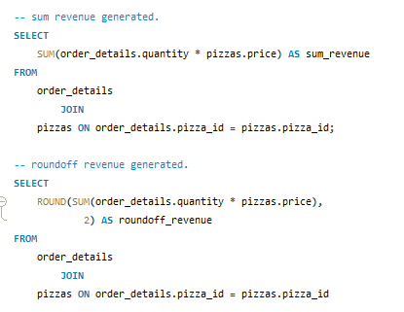
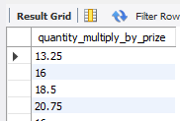
-- Calculate the total revenue generated from pizza sales.

Slide 9
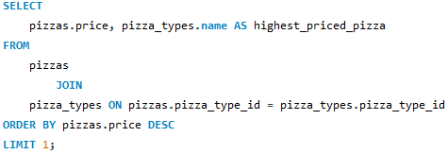
-- Identify the highest-priced pizza.

Slide 10
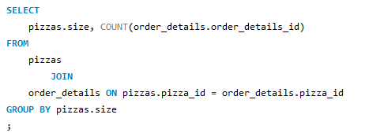
-- Identify the most common pizza size ordered.

Slide 11
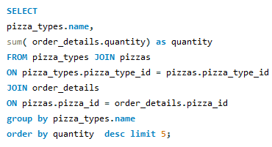
-- List the top 5 most ordered pizza types along with their quantities.

Slide 12
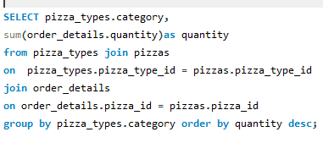
-- Join the necessary tables to find the total quantity of each pizza category ordered.

Slide 13

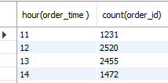
- Determine the distribution of orders by hour of the day.

Slide 14
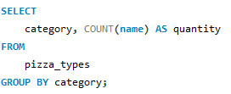
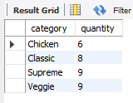
-- Join relevant tables to find the category-wise distribution of pizzas.

Slide 15
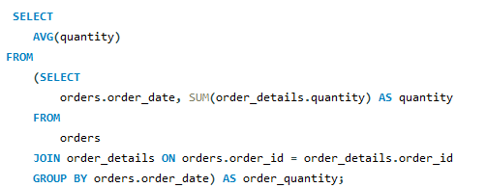
-- Group the orders by date and calculate the average number of pizzas ordered per day.

Slide 16
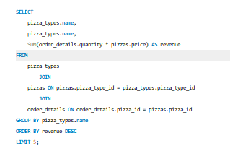
-- Determine the top 3 most ordered pizza types based on revenue.

Slide 17
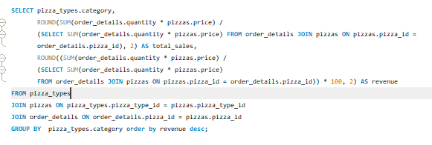
-- Calculate the percentage contribution of each pizza type to total revenue.

Slide 18
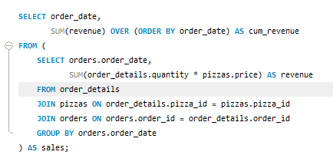
-- Analyze the cumulative revenue generated over time.

Slide 19
“WRAPPING UP : A SLICE OF SQL SUCCESS”
"Served Fresh by Minakshi Mishra"

